Slide 1

Sprocket Central Pty Ltd
Data Analytics Approach
Neha Patil

Slide 2
Agenda
Introduction
Data Exploration
Model Development
Interpretation

Slide 3
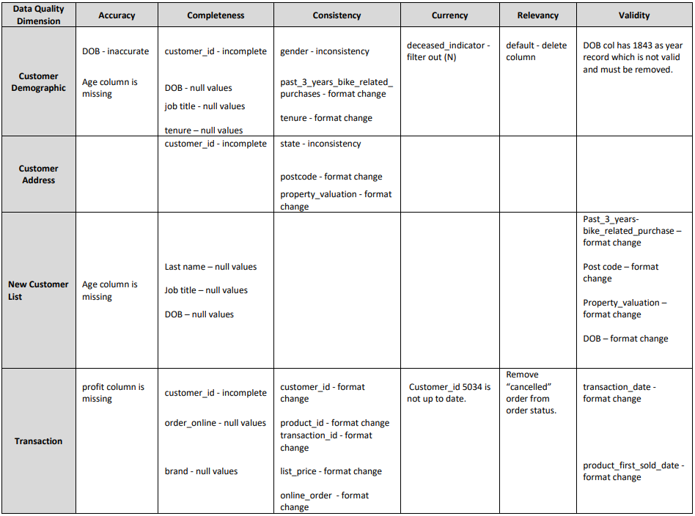
Introduction
Stage 1: Data Quality Assessment Overview
Key Issues for Data Quality Assessment:-
Accuracy: Correct values
Completeness: Data fields with values
Consistency: Values free from Contradiction
Currency: Values up to Date
Relevancy: Data items with value meta-data
Validity: Data containing allowable values
Uniqueness: Records that are duplicated
An email with a detailed analysis for the above mentioned issues has been sent.
Summary Table

Slide 4
Introduction
Identify Top 1000 Potential Customers to Target
Outline of problem:-
Sprocket Central Pty Ltd is a company that specializes in high quality bikes and cycling accessories.
Their marketing department is evaluating offered data in order to raise business sales.
The goal is to analyze and view the trends in the three datasets provided and then recommend 1000 high-value customers from a list to be targeted to drive the most value for the organization.
Contents of Data Analysis:-
Customers Age Distribution
Customers Gender Distribution
Wealth Segment Distribution
Job Industry Distribution
Distribution of Cars owned
Distribution of Bike purchased in last 3 years
RFM Analysis and Customer Segmentation
The proposed strategy is broken down into three stages: Data Exploration, Model Development and Interpretation

Slide 5
Data Exploration
Customer Distribution by Age
A large proportion of our customers are between the ages of 41 and 50.
After the age group 31-40, there is a noticeable steep increase of customers, followed by a steep decline since the age group 41-50.
Customers in the age groups 21-30 and 31-40 are quite similar, and the same is true in the age groups 51-60 and 61-70.
Customers aged 70+ make up a small percentage of the total.

Slide 6
Data Exploration
Customer Distribution by Gender
Female customers surpass male customers by a 2% margin.
The Solex Brand is the most popular among both genders, however females outnumber males in total purchases.
Female purchase numbers are higher than male purchase numbers in all brands.

Slide 7
Data Exploration
Profit Distribution of Age Group by Wealth Segment
The biggest number of customers are categorized as 'Mass Customer' in all age groups.
After Mass Customer,' the second best category is 'High Net Worth.’
In some age groups, such as the 21-30 and 41-50, ‘Affluent Customer’ customers have exceed ‘High Net Worth’

Slide 8
Data Exploration
Profit Distribution by Job Industry
The Financial, Entertainment, and Retail industries provide the most profit per customer for the business.
Despite the fact that the total profit from the Retail and Entertainment industries is not the highest, we still have a high profit per customer value.
Although the health industry is the third most profitable, its profit per customer is slightly low when compared to other profitable industries.
The Financial and Manufacturing are the company's most profitable industries, with the highest profit numbers. In Addition, Health Industry is not far behind.

Slide 9
Data Exploration
Distribution of customers owning a car by states
The state with the most car owners is New South Wales (NSW).
New South Wales (NSW) appears to have a larger population from which the data was obtained.
Queensland (QLD) is almost equally split. Both of these figures are much lower than those in New South Wales.
The number of people who do not own a car in Victoria (VIC) is slightly higher than the number of people who do.

Slide 10
Data Exploration
Distribution of Bike purchased in last 3 years
The Financial, Health, and Manufacturing Industries have accounted for the majority of bike purchases in the last three years.
The telecommunications industry makes the fewest purchases.
When compared to other age groups, the 41-50 age group has the most bike-related purchases.
The other age groups account for nearly half of the highest age group.

Slide 11
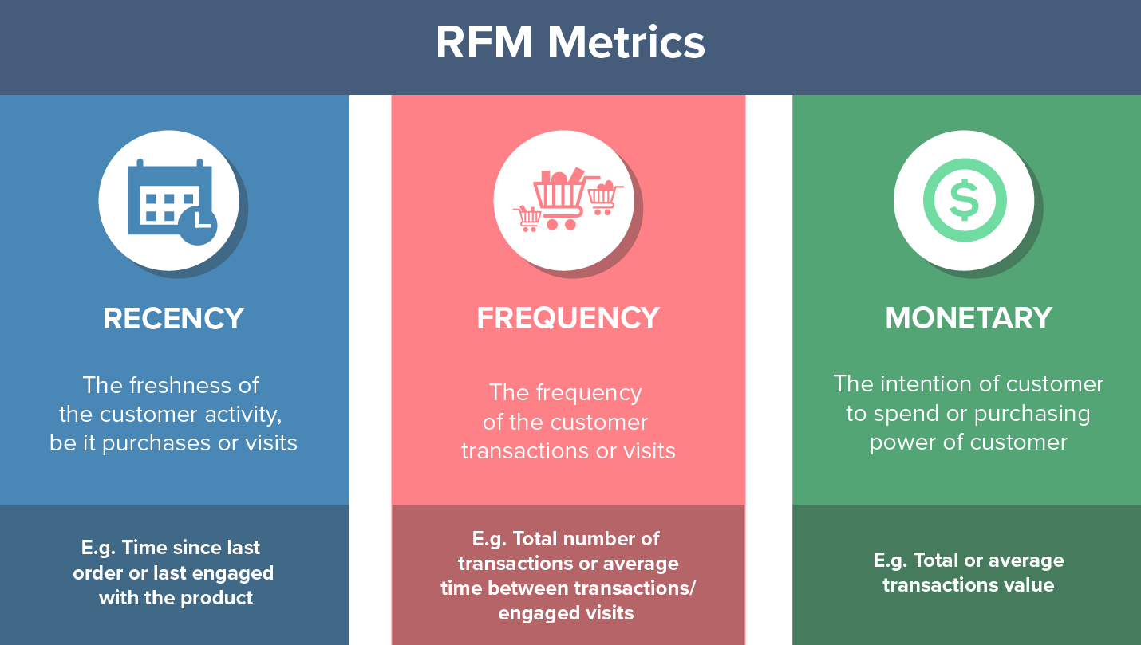
Model Development
RFM Analysis for Customer Segmentation
RFM Analysis is used to determine which customers a business should target to increase its revenue and value
The RFM (Recency, Frequency and Monetary) model classifies customer with different levels of engagement with business within these three categories
The customers who are more recent, purchase frequently and spend more money are recognized high value customers

Slide 12
Model Development
Customer Segmentation Definition table
Customer Category | Description | RFM Value
Platinum Customer | Most recent purchase, buys often and spends large amt of money | >433
Very Loyal | Most recent purchase, buys often and spends good amount of money | <=433
Becoming Loyal | Relatively recent purchase, bought more than once and spends good amount of money | <=413
Recent Customer | Bought recently, not very often, average money spent | <=344
Potential Customer | Bought recently, never bought before, spent small amount | <=324
Late Bloomer | No purchases recently, but RFM value is larger than average | <=311
Losing Customer | Purchases was a while ago, below average RFM value | <=233
High Risk Customer | Purchases was long time ago, frequency is quite high, amount spent is high | <=211
Almost Lost Customer | Very low recency, low frequency, but high amount spent | <=132
Lost Customer | Very low RFM | <=112

Slide 13
Model Development
Customer Segmentation using RFM Analysis

Slide 14
Interpretation
Final Targeting Methodology
The majority of customers between the ages of 41 and 50 should be targeted.
Females have made slightly more bike-related purchases in the last three years than males.
Solex is the most popular brand among both males and females.
In all age categories, the largest number of customers are categorized as 'Mass Customer.’
The Financial, Entertainment, and Retail industries provide the most profit per customer for the business.
The Financial and Manufacturing are the company's most profitable industries. In addition, Health Industry is not far behind.
Victoria (VIC) is a state where the number of people who do not own a car is slightly higher than the number of people who do
We should start targeting customers which fall under following three categories:- Platinum Customer, Very Loyal and Becoming Loyal

